Slide 1

Guided by :
Prof. Y. B. Sanap
Presented By :
Riddhi Arun Pawar
(3rd year Computer Technology)

Slide 2

W E L C O M E
Blockchain
“ Nobody alone is a trusted user rather,
Everybody together is accountable for trust of the system ”

Slide 3
CONTENTS
Types of Blockchain
Nodes in Blockchain
Logical Architecture
6
4
2
Features
Introduction
Consensus
5
1
3

Slide 4
CONTENTS
Ethereum and Hyperledger
Advantages and Disadvantages
Future Scope
Technology stack for Dapps
9
7
10
8

Slide 5

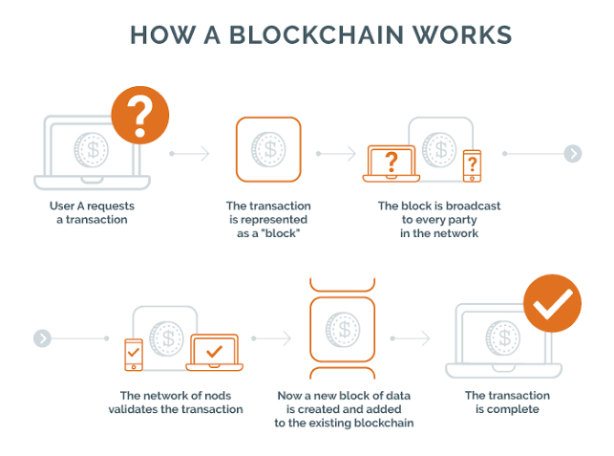
1. What is Blockchain ? Technology behind Bitcoin
It was introduced in 2008 by pseudo name Satoshi Nakamoto
“Blockchain is a decentralized, distributed, public ledger system”
How Blockchain works ?

Slide 6
2. Logical Architecture of Blockchain Technology
Block
Header
N-1
Timestamp
Version
Merkle Root
Nonce
Difficulty Target
N
Previous Hash
Data
N+1
List of Transactions

Slide 7
3. Features of Blockchain

Slide 8
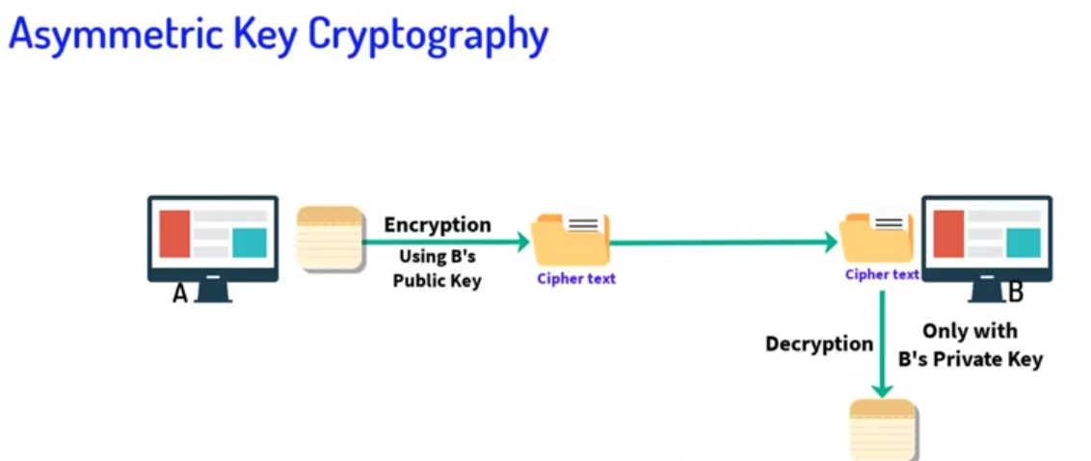
3.1 Cryptography in Blockchain
Confidentiality
Integrity
Asymmetric Key Cryptography

Slide 9
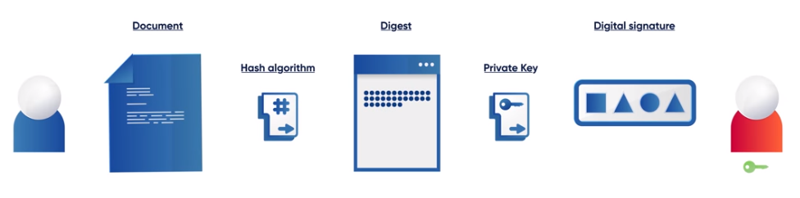
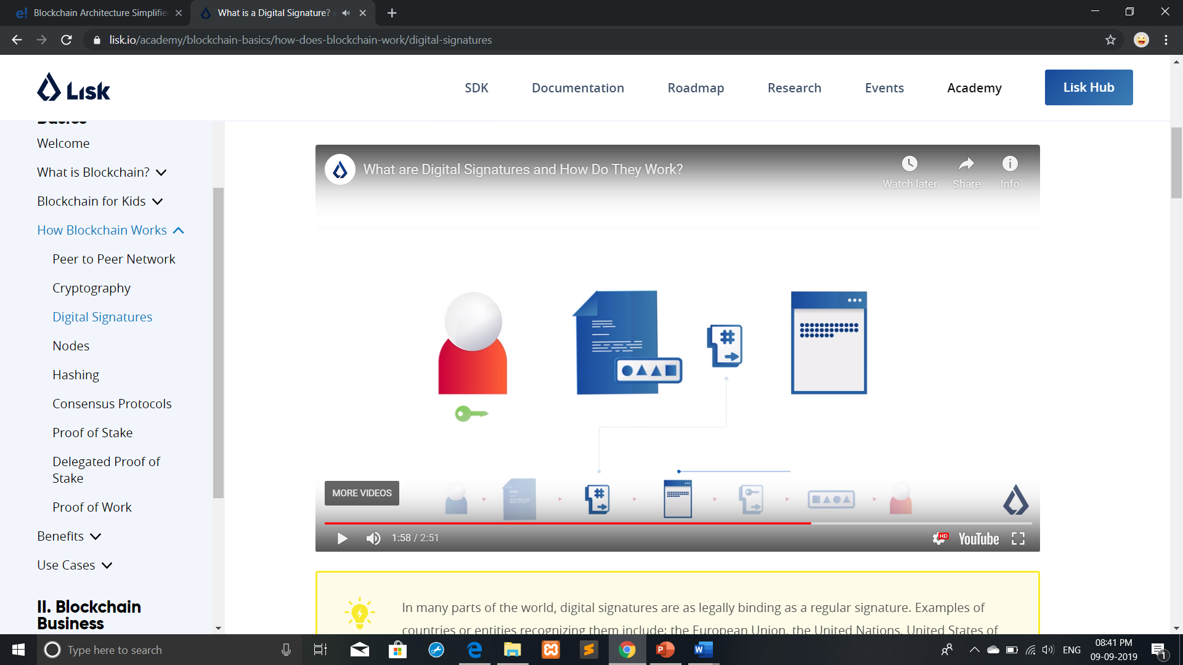
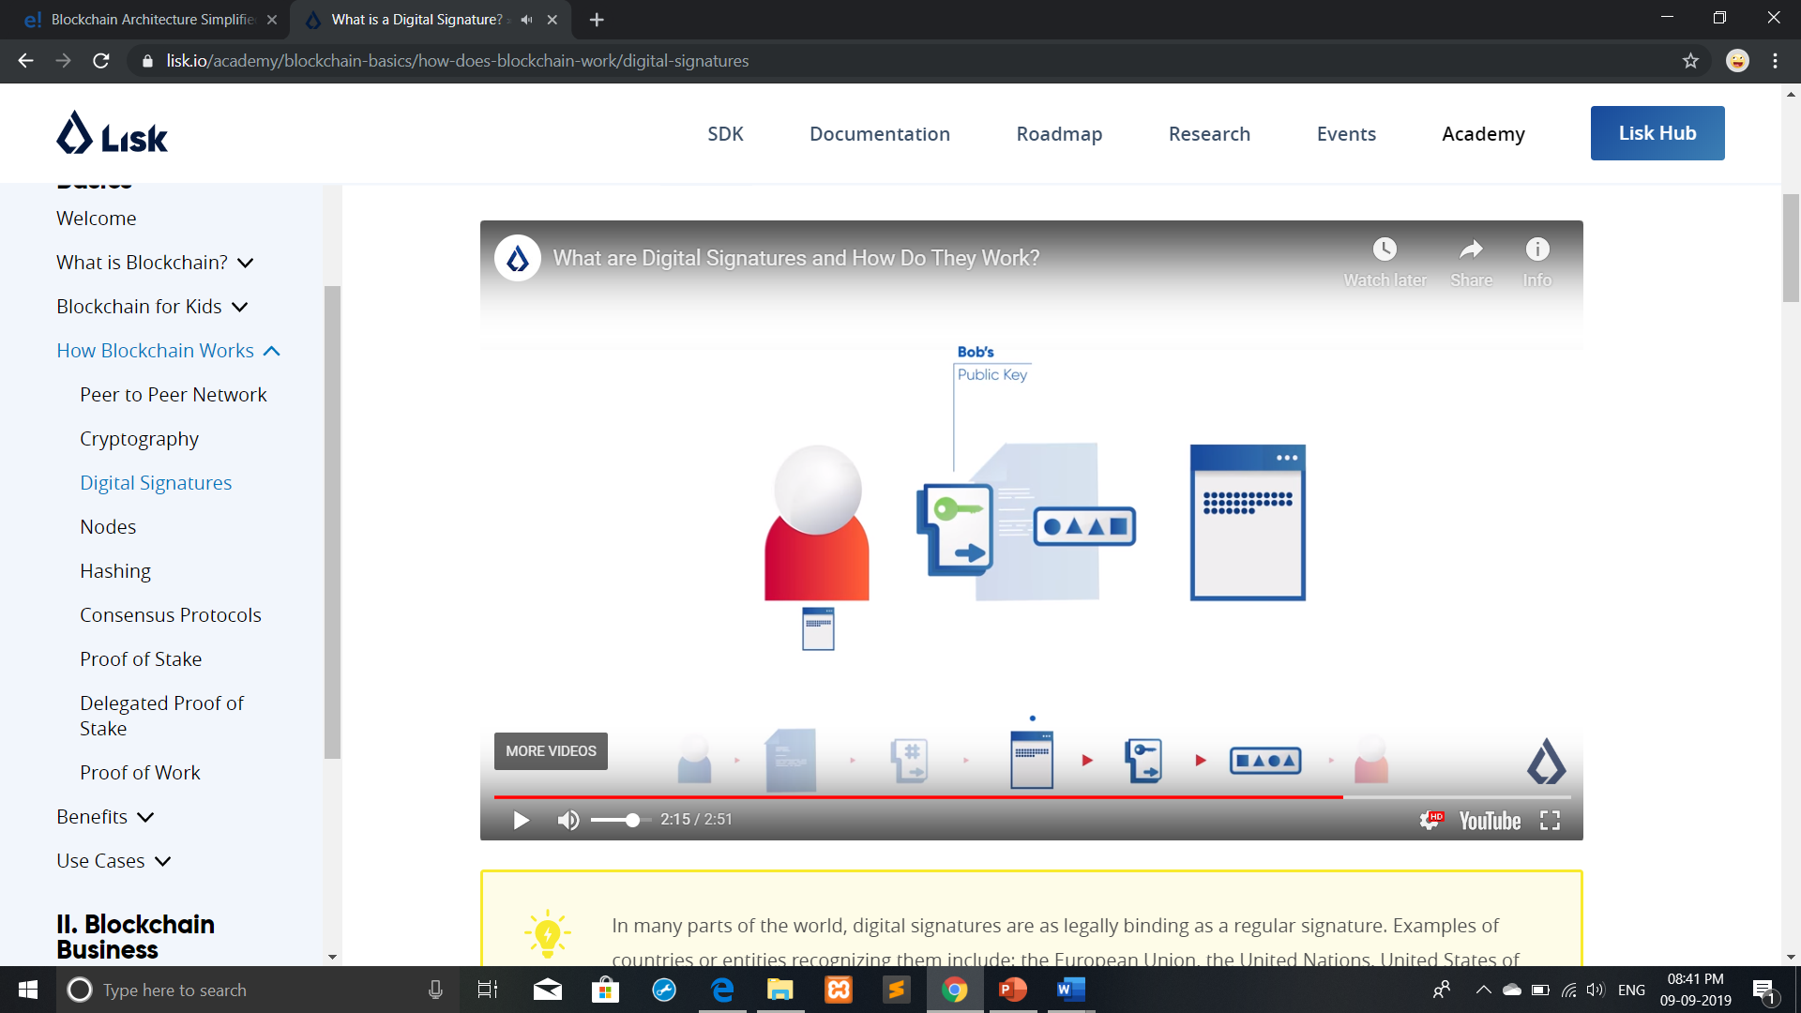
3.2 Digital Signature in Blockchain
Non Repudiation
Authentication
A
B
Sender’s Side
1
2
Public Key
B
B
Receiver’s Side
Must match !

Slide 10
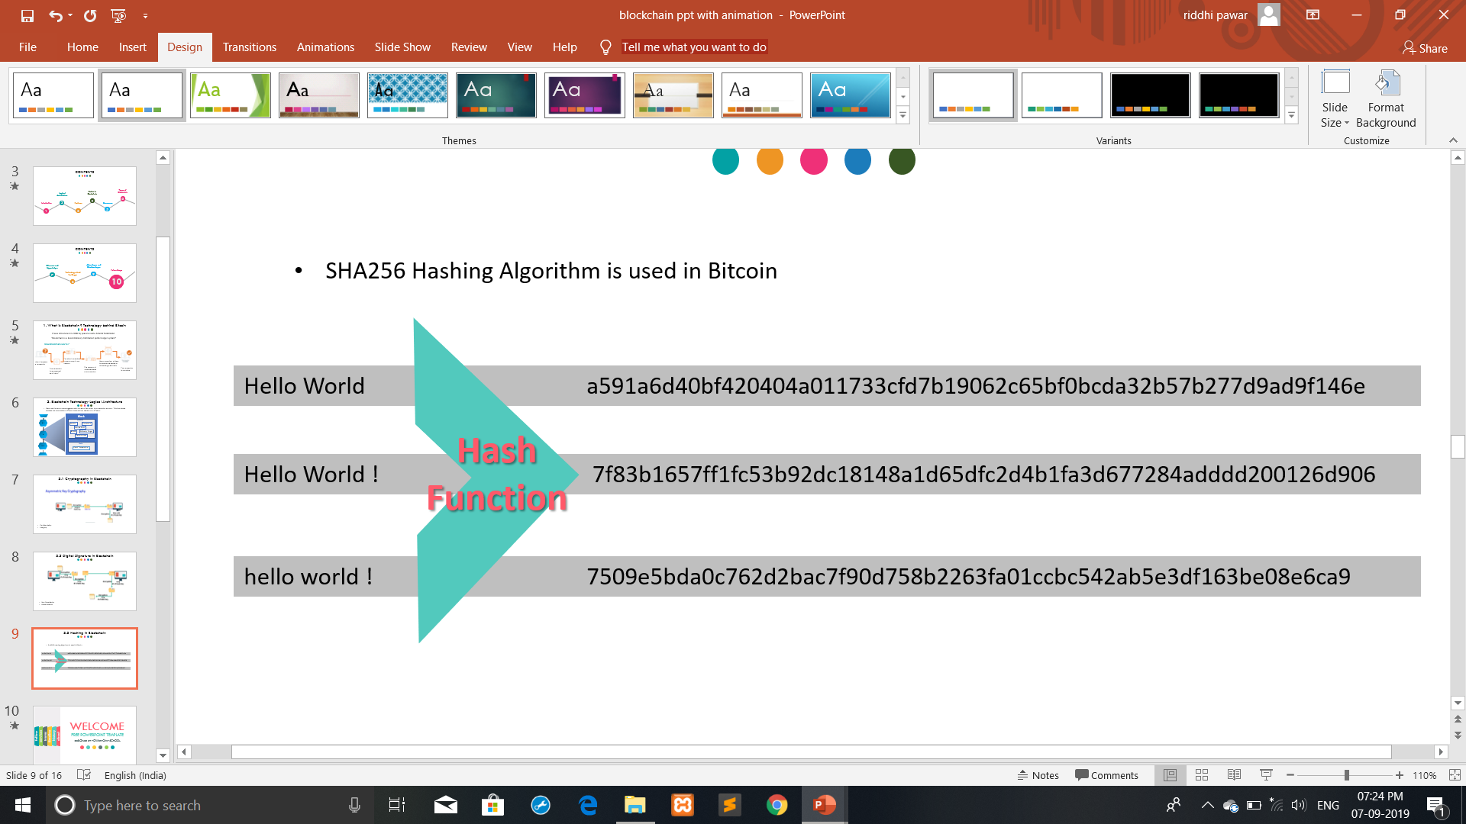
3.3 Hashing in Blockchain
Immutability
SHA256 Hashing Algorithm is used in Bitcoin’s Blockchain

Slide 11
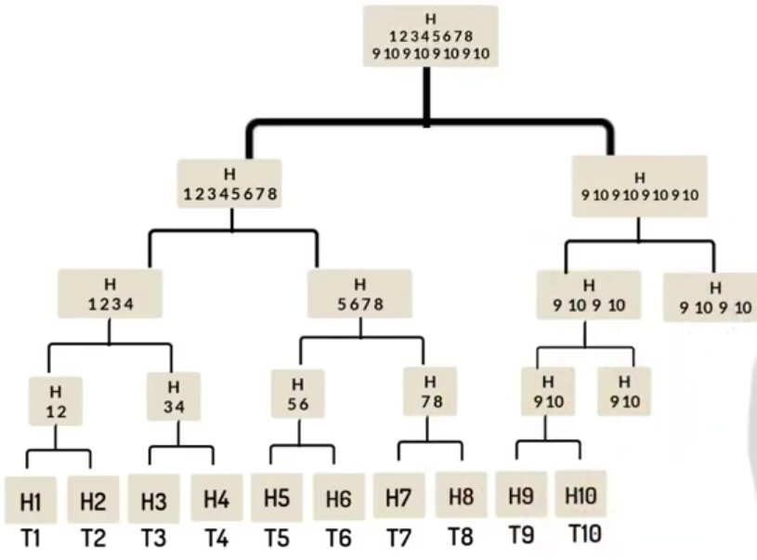
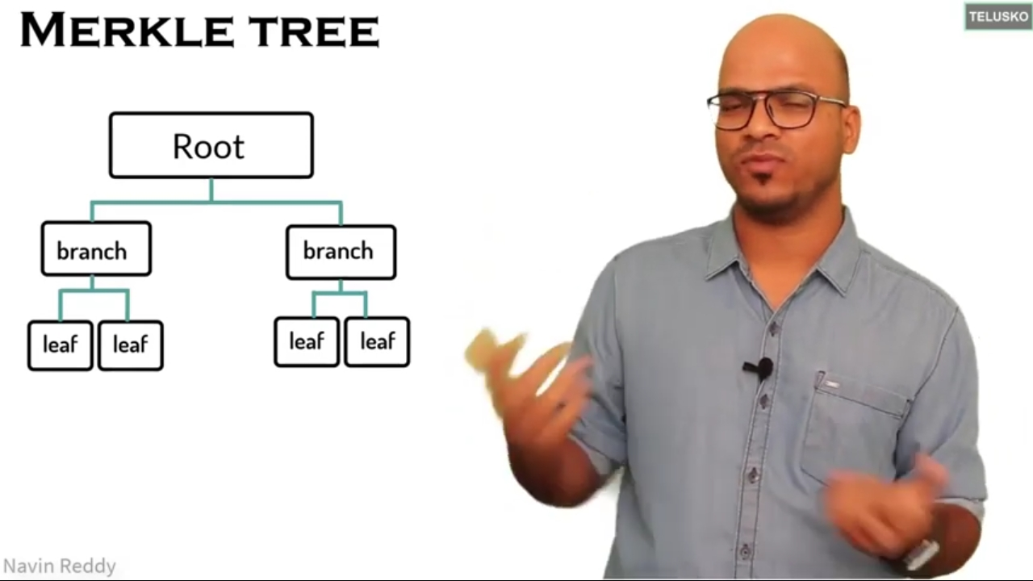
3.4 Merkle Tree and Merkle root
It is the technique used to generate single Hash value of a block containing thousands of transactions
Example :

Slide 12
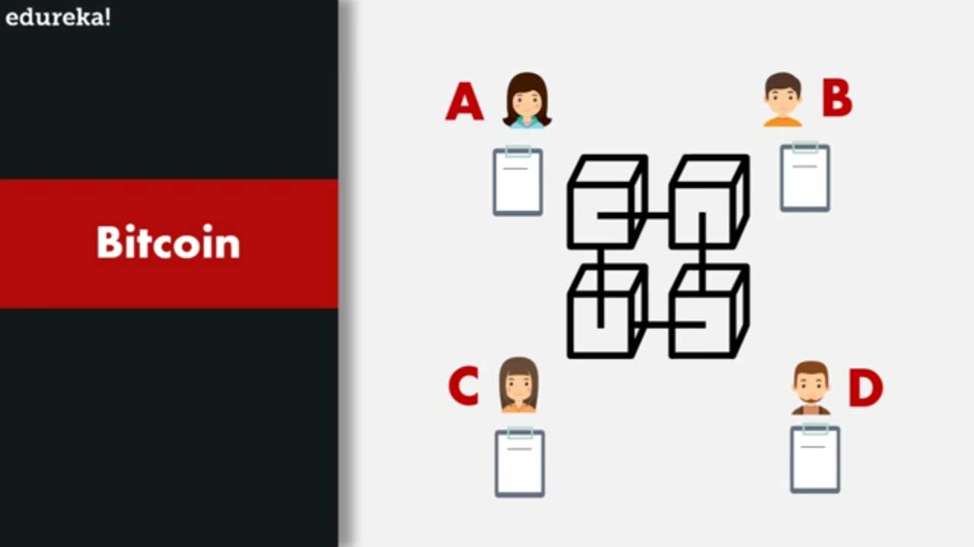
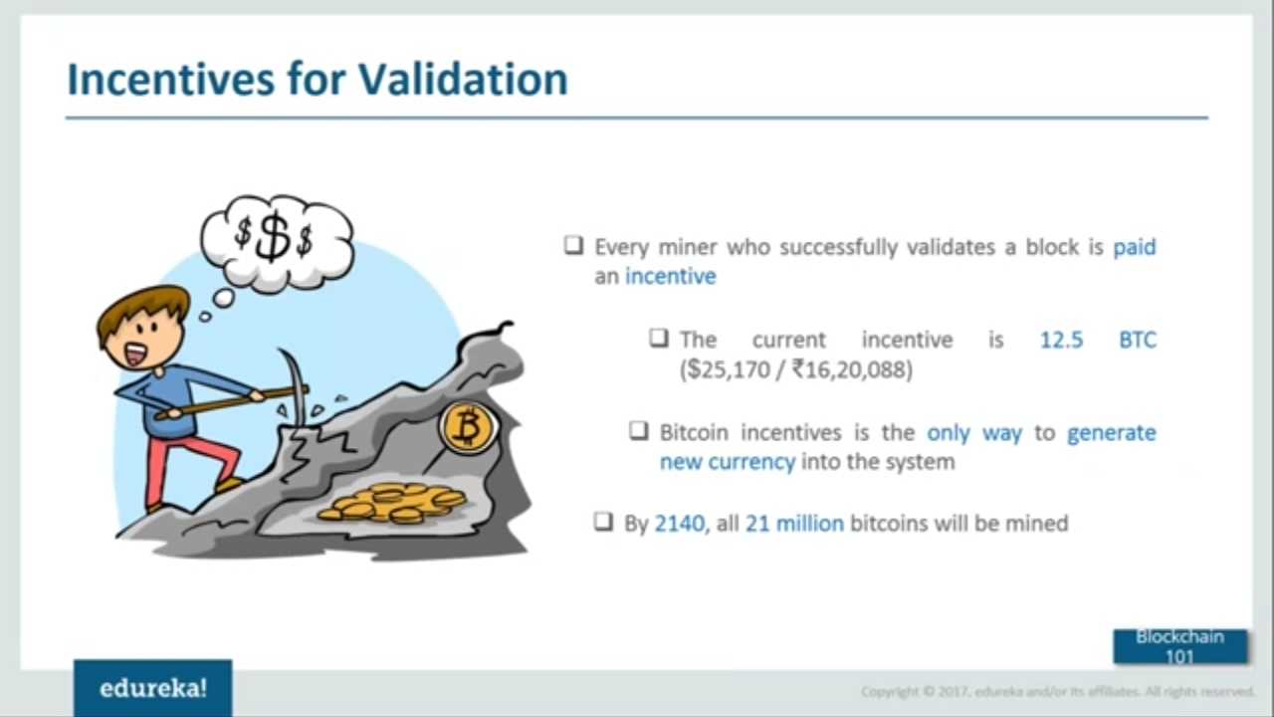
4. Consensus in Blockchain
Consensus Algorithms used are :
1. PoW (Proof of Work) –
Used in Bitcoin
Based on game theory
2. PoS (Proof of Stake) –
Used in Ethereum
3. PoET (Proof of Elapsed Time) –
Built by Intel
4. PoD (Proof of Deposit)
5. PoC (Proof of Capacity)

Slide 13
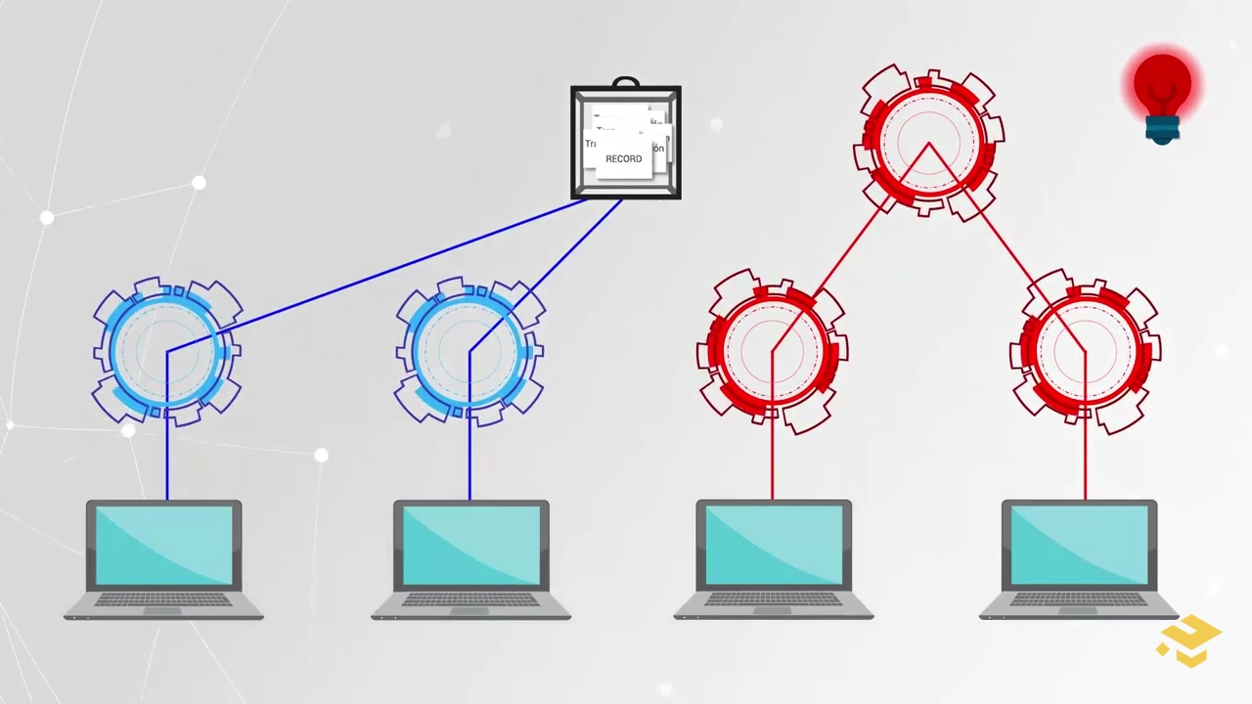
5. Nodes in Blockchain
Types of Nodes :-
1) Full Node
2) Partial Node(Light Node)
PEER TO PEER NETWORK
Miner
Large amount of GPU’s and CPU’s

Slide 14
6. Types of Blockchain
Public
Blockchain
- All data is available openly.
Anyone can be a part of it.
slower because it have to use PoW.
- For single company.
- Number of nodes contributing are controlled
and known.
faster because it don’t have to use PoW.
Private
Blockchain
Consortium
Blockchain
- Group of people or companies.
- Someone may be leading it.
- When organizations are ready to share the
Blockchain, but restrict data access
- faster because it don’t have to use PoW.

Slide 15
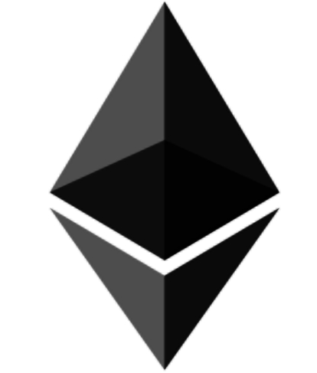
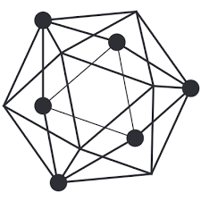

7. What is Ethereum ? What is Hyperledger ?
Ethereum :
Vitalik Buterin inventor of Ethereum
It is a platform used to run Decentralized Applications
2. Hyperledger :
-It is an open source project hosted by Linux Foundation
-It emphasizes on using Blockchain in B2B i.e. Enterprise market

Slide 16
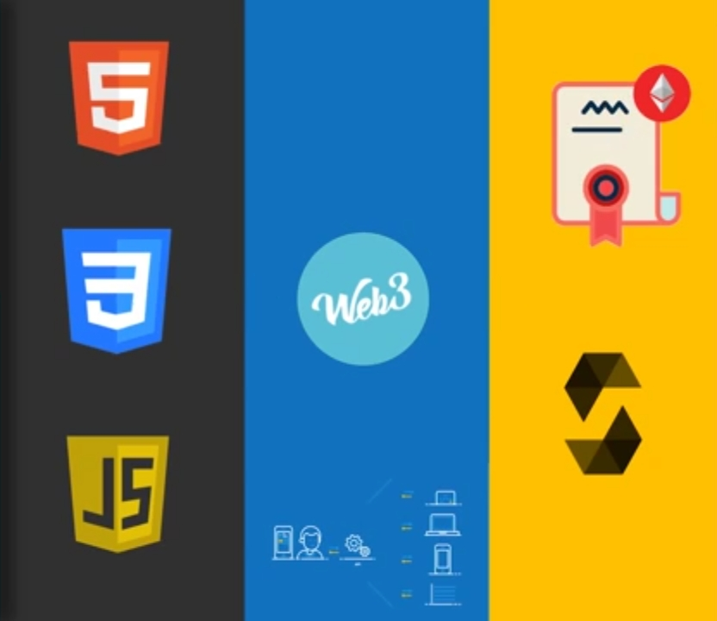
8. Technology stack for Dapps
Front End :
HTML, CSS, JavaScript, Angular, React can be used to design front end
Web 3 :
It is an API available in Java, JS, Go, Python
Back End :
Smart Contracts are used which are written in solidity

Slide 17
9. Pros & Cons
Advantages Disadvantages
1. Distributed
2. Trustless system
3. Backups
4. Immutable
5. Transparency
6. Removes intermediate Fees
7. Availability (Failure of Node doesn’t affect)
1. 51% attacks
2. Wastage of Resources
3. Complex Concepts
4. Private keys

Slide 18
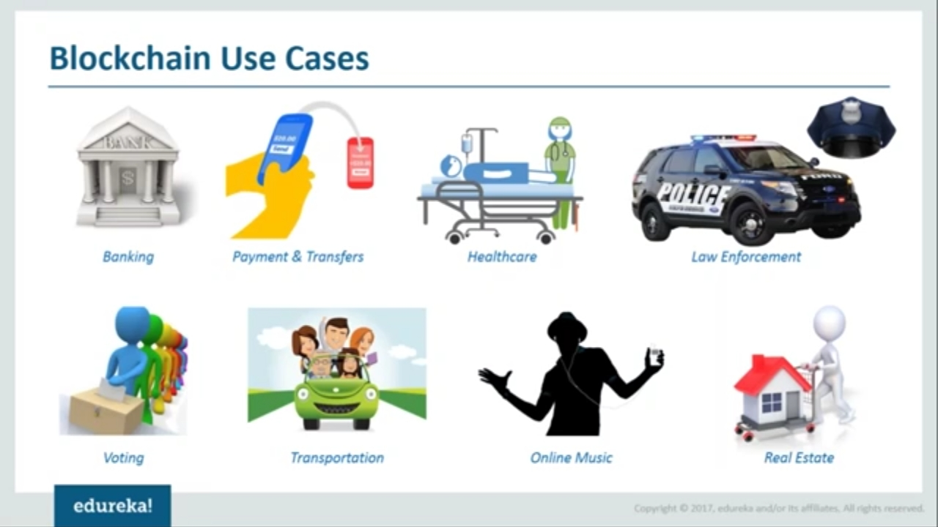
10. Future Scope
01
02
03
04
Banking
Healthcare
Law Enforcement
Voting
Bitcoin
Followmyvote.com

Slide 19
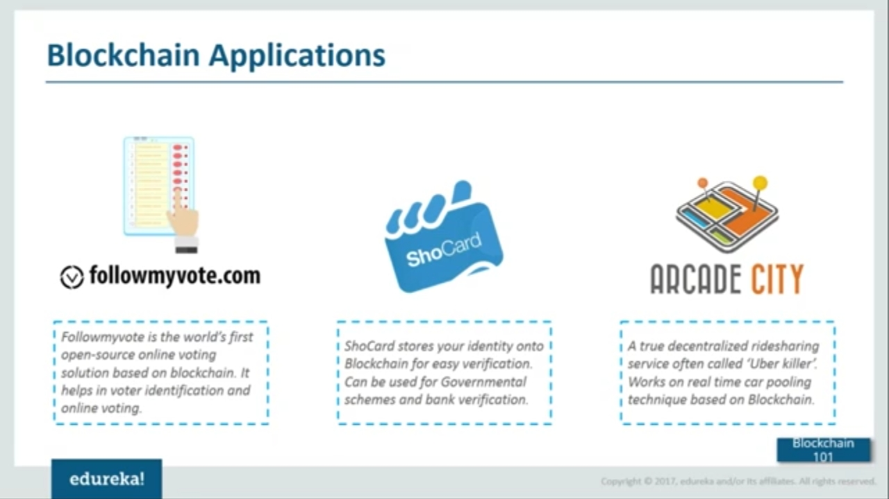
10. Future Scope
05
06
07
08
Transportation
Real Estate
Online Music
Identity for All
ShowCard

Slide 20
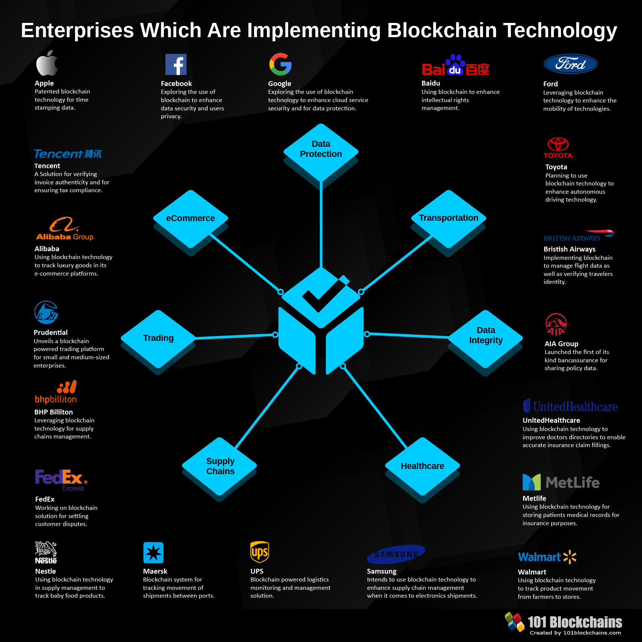

Slide 21
References
www.powerpointschool.com
www.telusko.com
www.eduka.co
www.binance.vision
hackernoon.com
www.guru99.com
www.javatpoint.com
www.coindesk.com
blockgeeks.com
www.researchgate.net
lisk.io
medium.com

Slide 22
Conclusion

Slide 23
Thank You
?
Any Questions

